Slide 1
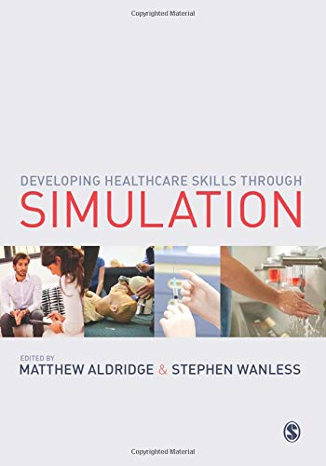
Simulation-based Education: from rehearsal to reality
Matthew Aldridge RN, RNT, MEd, BSc(Hons), SFHEA
Principal Lecturer for Skills and Simulation, Institute of Health

Slide 3
What is simulation?

Slide 5
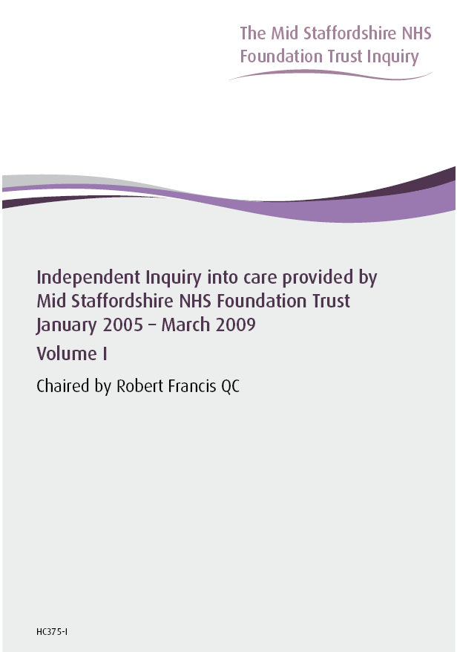
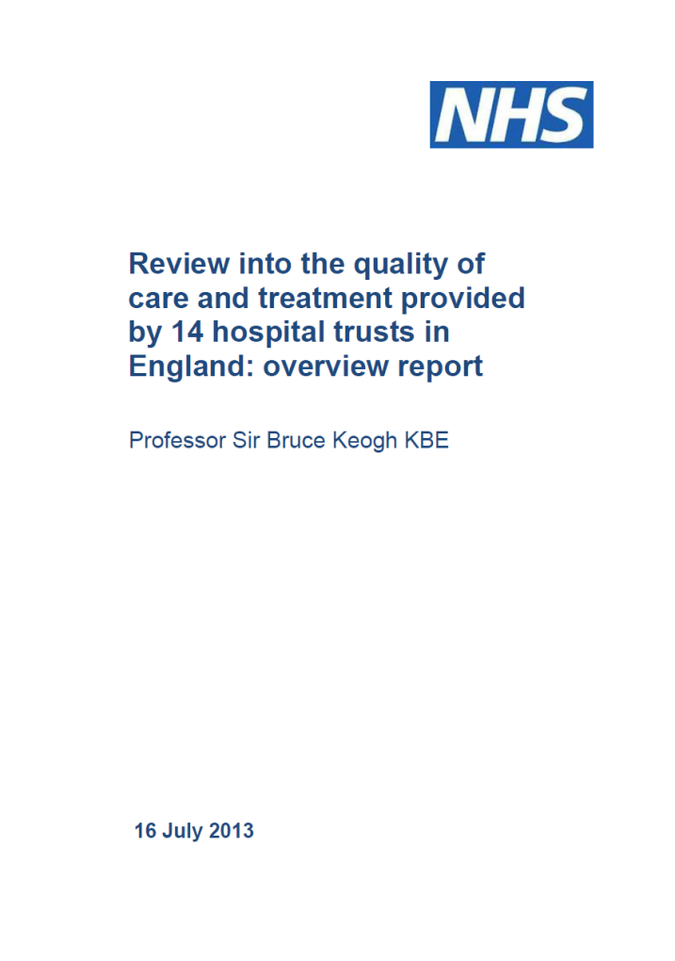
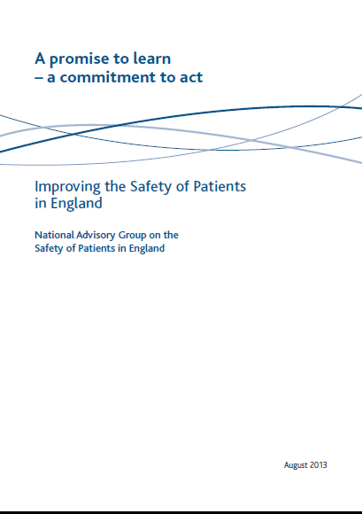
Notes:
In the past 10 years, we’ve had some harsh lessons to learn, and there has been a big drive on producing recommendations for a safer workforce can safer patient care, a lot of these talk about expanding and developing opportunities for enhancing education.

Slide 6
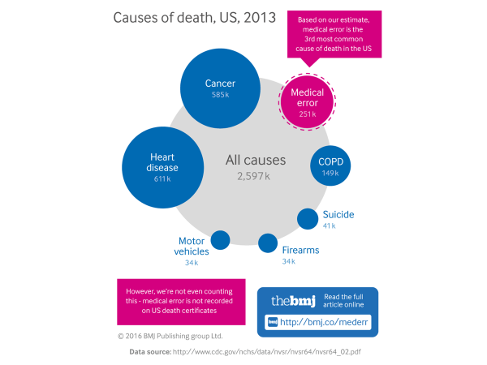

Slide 9
Virtual reality

Slide 10
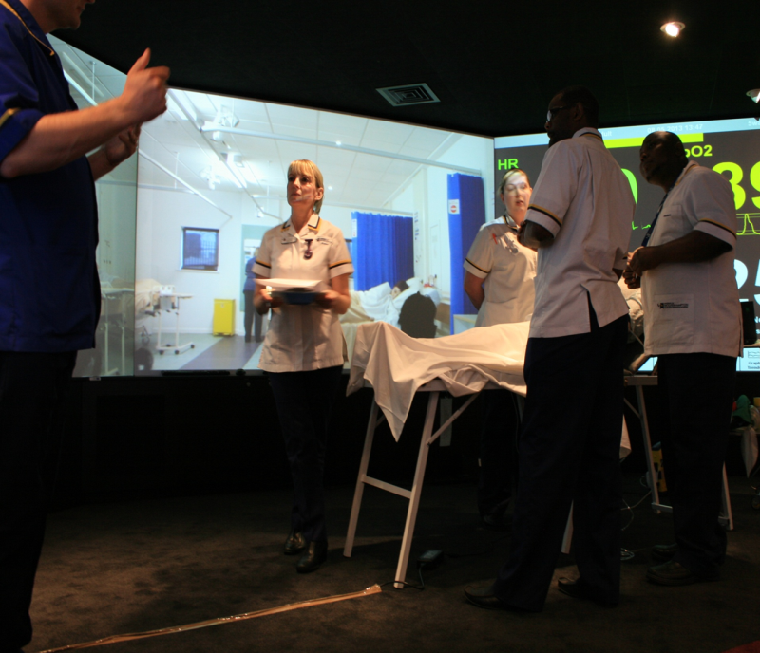
Immersive reality
Blending video, audio, lighting and “smells” with real-world equipment and procedures

Slide 11
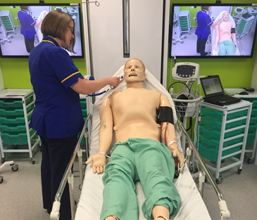
Human patient simulators
Replicate human physiology
Heart sounds/pulses
Breath sounds
Moving chest/eyes
Ability to catheterise, cannulate, insert airway devices
Can allow for replicate medical emergencies and patient assessment skills

Slide 12
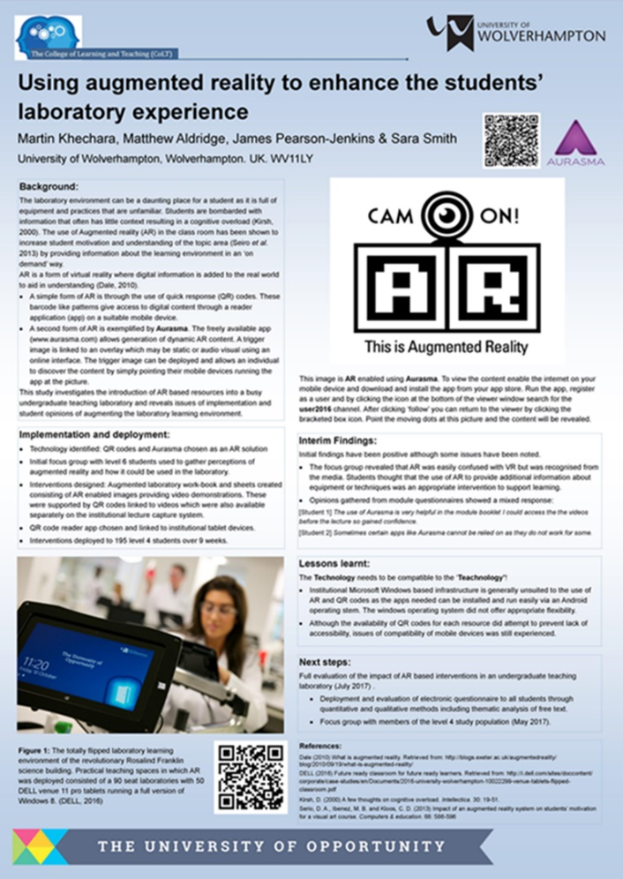
Augmented reality

Slide 14
matthew.aldridge@wlv.ac.uk

